Slide 1

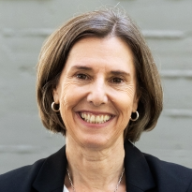
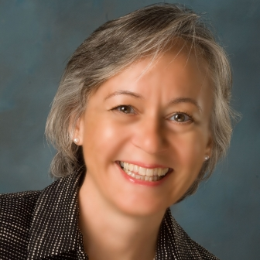
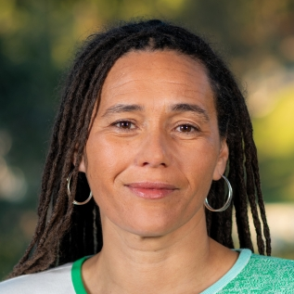
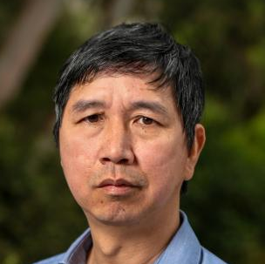
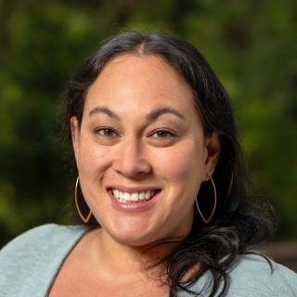
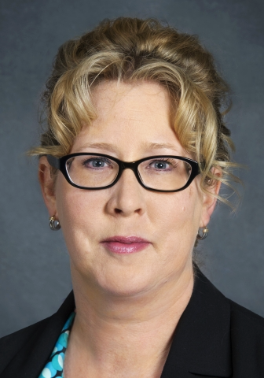
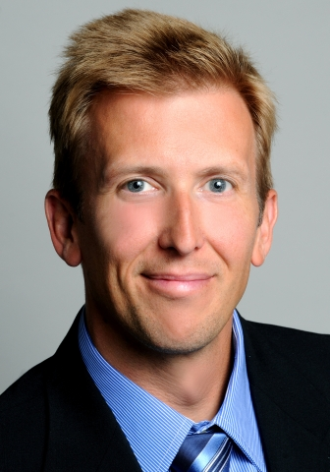
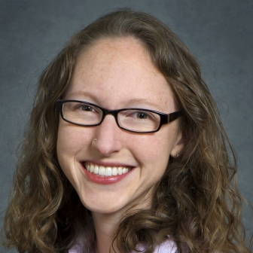

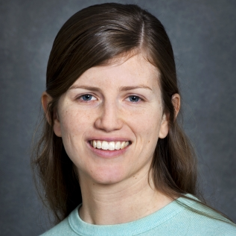
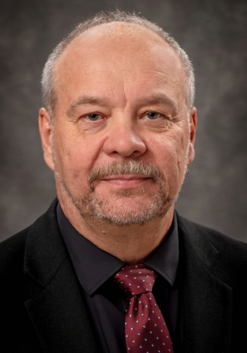
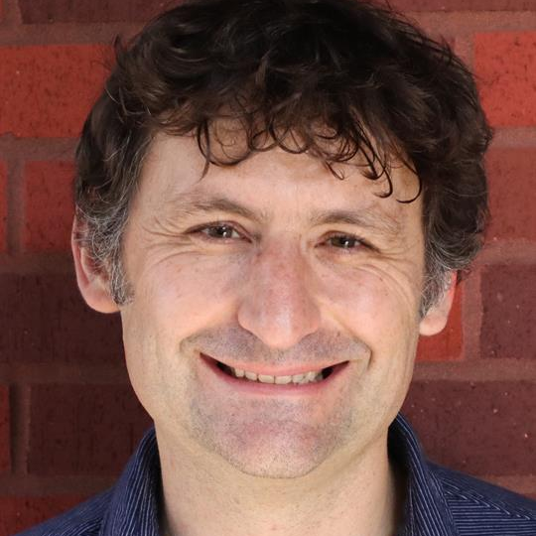
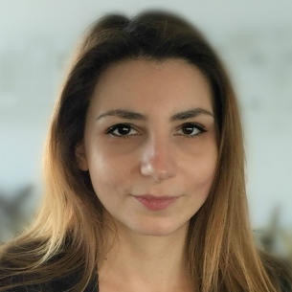
 | MARY ANN PIETTE, Associate Laboratory Director
SCIENCE
OPERATIONS
BUILDING & INDUSTRIAL ENERGY SYSTEMS DIVISION
Jessica Granderson Division Director
Tianzhen Hong, Research Deputy | Erin Harbin, Business Manager
Jerri Carmo Area Deputy
PROGRAM & BUSINESS DEVELOPMENT Alecia Ward
ENERGY ANALYSIS DIVISION
Tom Kirchstetter Division Director |  | Tom Kirchstetter Division Director
Corinne Scown, Research Deputy | Peter Larsen, Research Deputy | Colleen Kantner, Operations Deputy
ENERGY TECHNOLOGIES & SYSTEMS DIVISION
Robert Kostecki Division Director
Shannon Boettcher, Research Deputy | Vassilia Zorba, Operations Deputy

